Slide 1
Tile Titan
By: Lance && Jessie

Slide 2
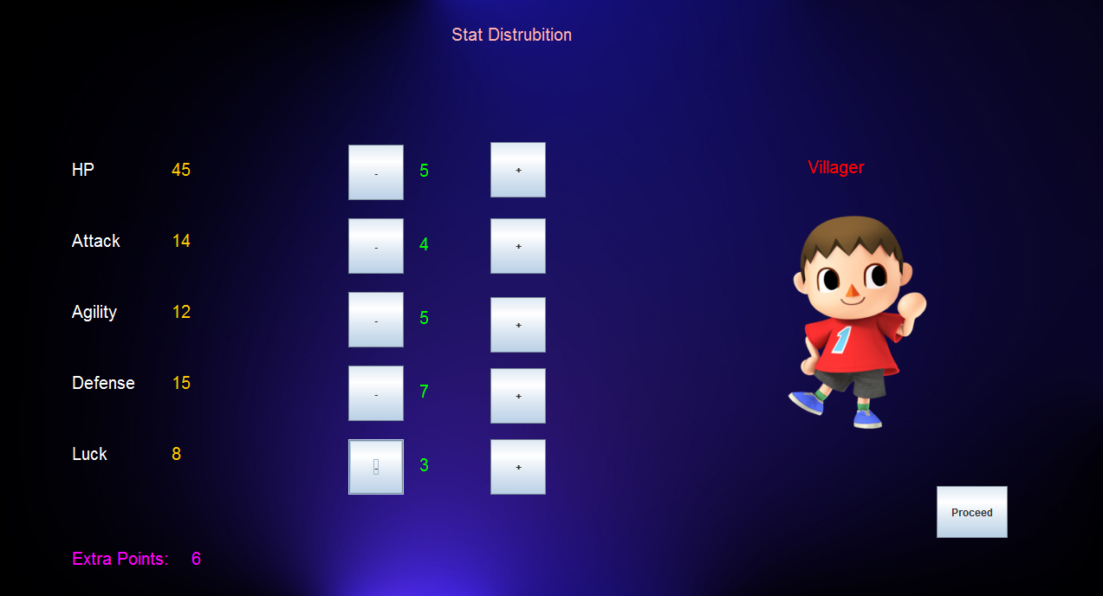
Tile Titan
Board Oriented
Customizable Character
Enemy Combat
10+ Classes
Uses of both Superclasses and extending
Optimized for Cohesion and Coupling

Slide 3
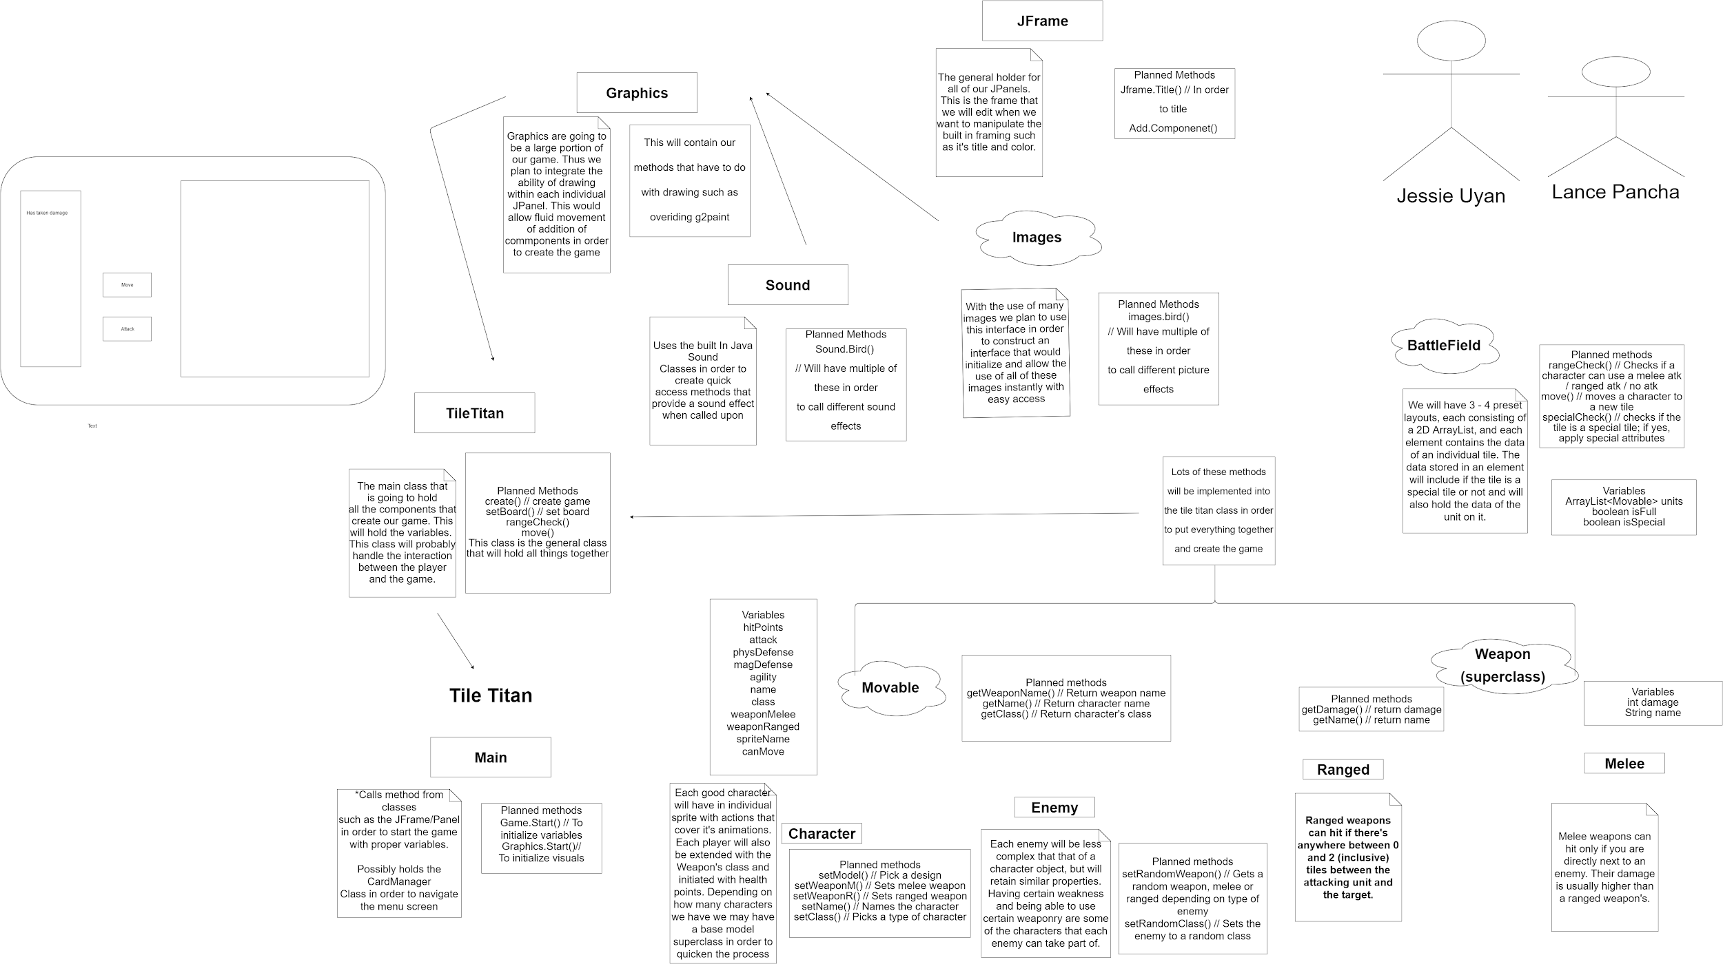

Slide 4
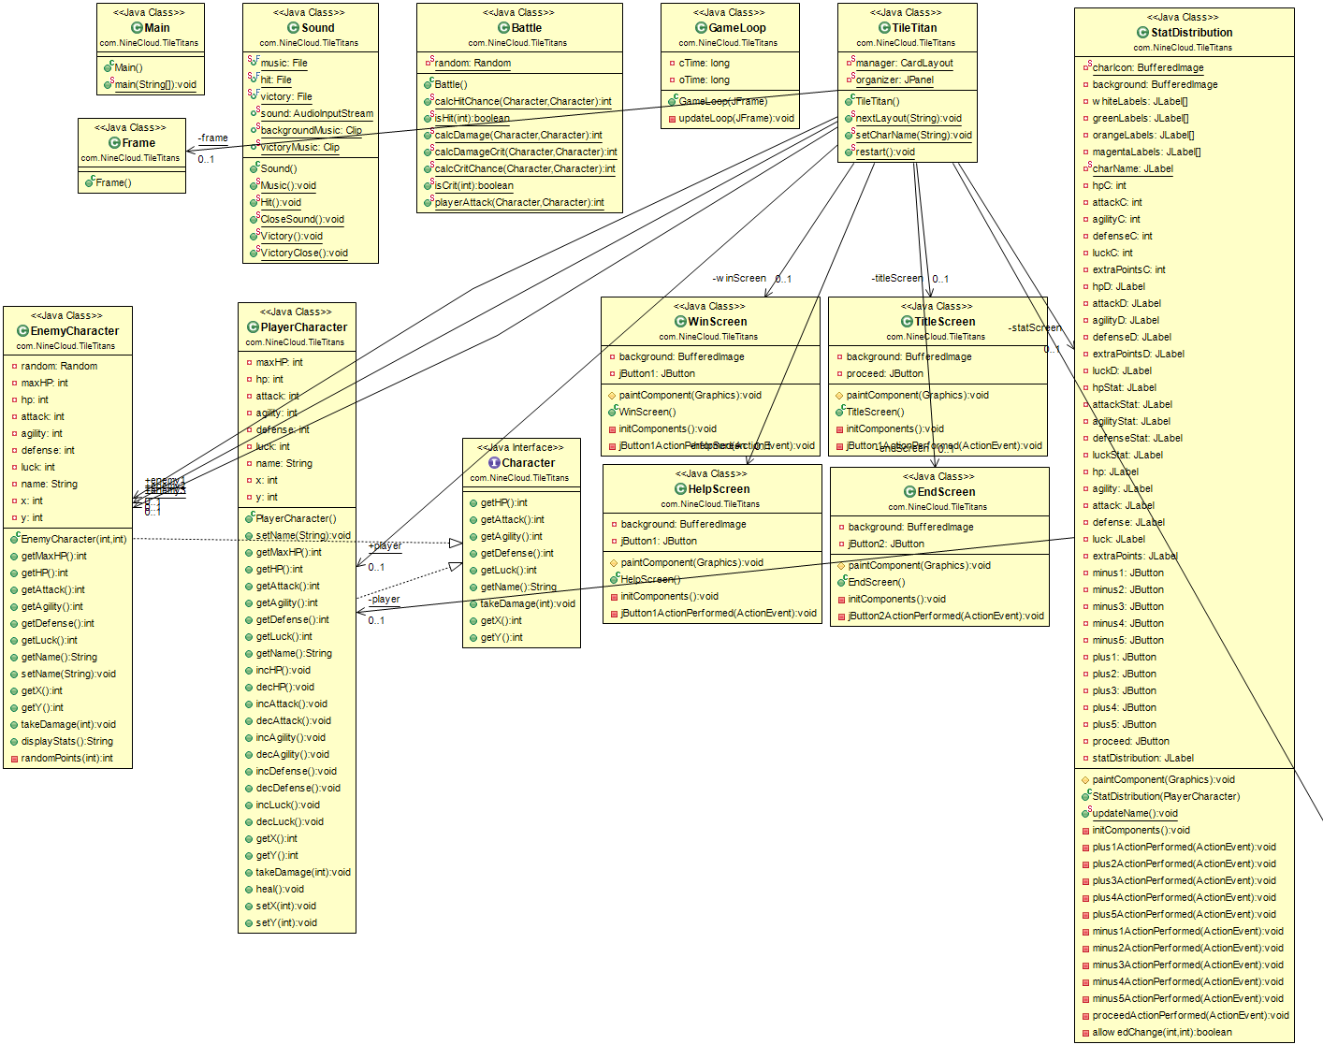
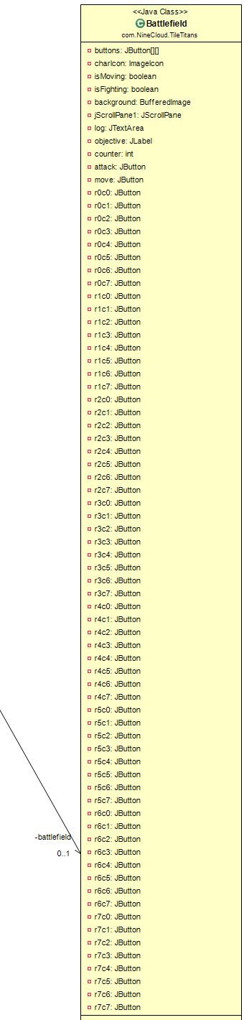
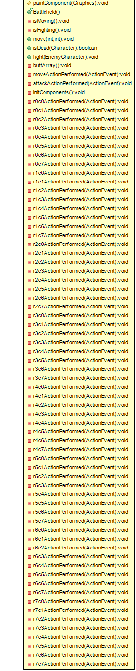

Slide 5
Main
public static void main (String Args[]){
TileTitan game = new TileTitan();
}
Plain and Simple, What a main should be!
From UML
Planned methods
Game.Start() // To initialize variables
Graphics.Start()// To initialize visuals
At first we wanted to planed to invoke more than just the game, but a cleaner approach appeared and so we did it.

Slide 6
TileTitan Class
Our entire game in one class. This class takes methods,classes and puts it together to construct the game.
GameLoop
JFrame
Tile Titan
BattleField
Enemy

Slide 7
Example Code for TileTitan Class
frame = new Frame();
organizer = new JPanel(new CardLayout());
frame.add(organizer);
player = new PlayerCharacter("Bobby Ross");
statScreen = new StatDistribution(player);
battlefield = new Battlefield();
organizer.add(statScreen,"StatDistribution");
organizer.add(battlefield, "Battlefield");
manager = (CardLayout) organizer.getLayout();
manager.show(organizer, "StatDistribution");
JFrame
Battlefield & Player
Class initiates different classes in order to construct our game and puts it together conviently in once class.
Panel Manager

Slide 8
Visual Framing
Our approach to displaying our different screens consisted of created different panels in different classes. From there we added them to the TileTitan class and compiled all of them into a singular JFrame using a CardLayout manager.
TitleScreen
BattleField
Instructions
title = new TitleScreen();
field = new BattleField();
instructions = new Instructions);
CardLayout
CardLayout is a subset class of the LayoutManager used to control GUI elements.
Here we use it to control the current screen that is being displayed.
TitleTitan

Slide 9
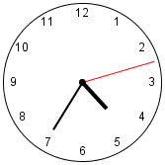
GameLoop
Our game loop class is in charge of handling the updating of graphics.
We use Java’s System Clock in order to detect when to refresh the paint variable of our components
if((cTime - oTime) == 30){
oTime = System.currentTimeMillis();
frame.validate();
}
System Time

Slide 10


A Movable Interface
Variables
hitPoints
attack
physDefense
magDefense
agility
name
class
weaponMelee
weaponRanged
spriteName
canMove
Some variables planned from UML
Moveable
Both our character player and enemy use the moveable interface.
From this they gather variables and methods such as Health values and coordinates.
Player
Enemy

Slide 11
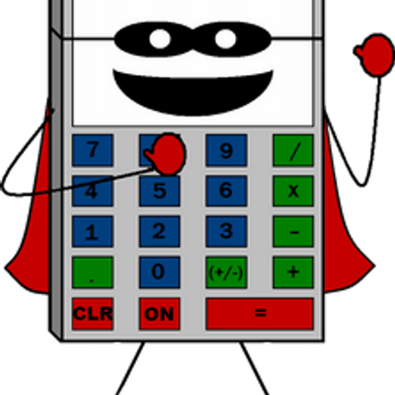
Battle
calcDamage(Movable a, Movable d){
return a.getAttack() - (int)((double)(d.getDefense()) * 0.75);
}
private int calcDamageCrit(Movable a, Movable d){
return (a.getAttack() - (int)((double)(d.getDefense()) * 0.75)) * 2;
}
Our battle class consist of where all our calculations take place.

Slide 12
Summary
Difficulty - Moderate
The program was not hard grasping the concepts necessarily hard to create, but when it came to looking at the cohesion and putting the puzzle together. There are modifications we needed to make sure the pieces fit.
Fun - Somewhat Fun
Since our program required a lot of similar items, lots of the code required tedious typing that really bore both of us. Aside from that, the programing and looking at are creation was a fun task.
Evaluation - Happy
Although the final product is missing a few features that we would have liked but are not implemented due to unforeseen problems. Our product is good for what we had the capablities to do.
TPIL (This program I learned) - A lot.
Theory crafting is a skill that is harder than expected. Pre- planning is key to making sure that your program turns out well, but you also must be adaptable in order to deal with any obstacle that may appear.

Slide 13
Questions?

